Slide 1
Encryption using Substitution techniques
BY:
K SIDHARTH RAO 2010030443
ABHIRAM VIDIYIYALA 2010030180

Slide 2
Title and Content Layout with List
ABSTRACT
PROBLEM STATEMENT
INTRODUCTION
LITERATURE SURVEY
METHODS
RESULT
CONCLUSION

Slide 3
ABSTRACT
As multimedia applications are used increasingly, security becomes an important issue of communication and storage of data. In the current scenario, where there are many incidents of data hacking data leakages, it is extremely important to store the data in a very secured manner. In this project we have discussed about one of the encryption techniques which will help us in ensuring the security of data while storing and transferring it from one source to the other.

Slide 4
PROBLEM STATEMENT
Security is one of the issue often face by web developer and software engineer. In today's life, computer and networking is essential to today's communication and transferring of data is essential when doing online banking, data transferring, sharing and more.
To have a secure data transfer, few method can be applied, and one of them is encryption of data, prepare it to be transferred in encrypted way and decrypted when the data want to be used.

Slide 5
INTRODUCTION
The art and science of keeping messages secure is called cryptography. It is practiced by cryptographers, and cryptanalyst are practitioners of cryptanalysis, the art and science of breaking the cipher text.
Earlier the requirement of information security within an organization was primarily provided by physical and administrative means. But the concept of network security became quite evident with the introduction of computers and later with introduction of distributed systems.
The need of cryptographic algorithm is to avoid threat to integrity, confidentiality and availability.

Slide 6
Substitution technique is a classical encryption technique where the characters present in the original message are replaced by the other characters or numbers or by symbols.
Substitution Technique:
Caesar Cipher
Monoalphabetic Cipher
Playfair Cipher
Hill Cipher
Polyalphabetic Cipher
One-Time Pad

Slide 7
LITERATURE SURVEY
Cryptology, which is the study of cryptosystems, encompasses two disciplines: cryptography and cryptanalysis. It is one of the major areas of study in information security. Cryptography is defined as the science and art of encrypting and decrypting data using some special measures. Encryption is the method of disguising plaintext in such a way as to hide its substance while decryption (which is the opposite of encryption) is unhiding the substance by changing the ciphertext to its original plaintext. Cryptanalysis, on the other hand, is the branch of science which deals with breaking the codes and extracting the hidden meaning, while the whole system which comprises both cryptography and cryptanalysis is called cryptosystem.

Slide 8
Cryptographic Algorithms (Ciphers)
A cipher is an algorithmic function which converts plaintext messages into unreadable forms by applying a set of transformation techniques to each letter in the plaintext. The particular transformations employed at any time are controlled by a secret key, called cryptographic key, used at that time. The security of the ciphertext is said to rest majorly on the secrecy of this key.
In a study in 2009, Poschmann wrote that ciphers can be classified using several criteria. According to one of such criteria, the ciphers are classified as symmetric key and asymmetric key. In symmetric key ciphers, the same key is used for both encryption and decryption. The key used for encryption is called the public key and the key used for decryption is called the private key. The public key can be revealed without compromising the security of the system while the corresponding private key, however, must not be revealed to any party.

Slide 9
Poschmann (2009) further wrote that, in symmetric encryption, ciphers can be classified into stream ciphers and block ciphers; stream ciphers obtain ciphertext by using the XOR of the plaintext and keystream (bi-wise).
They are grouped into two: synchronous stream cipher, whose key sequence does not depend on the plaintext and ciphertext but only on the previous elements of the key sequence and the initial key, e.g. One-time password (OTP); and asynchronous stream cipher, whose keystream depends on the plaintext or ciphertext, e.g. Cipher Feedback mode (CFB). Other examples of stream ciphers include RC4 and SEAL.
Block ciphers, on the other hand, operate on a fixed length block size. It can be considered simply as a large lookup-table (substitution cipher). In particular, identical plaintext blocks encrypt to identical ciphertextblocks. Examples include Data Encryption Standard (DES), 3Data Encryption Standard (3DES), Advanced Encryption Standard (AES), Blowfish, etc

Slide 10
The earliest known use of a substitution cipher, and the simplest, was by Julius Caesar. Since Julius Caesar used an additive cipher to communicate with his officers; for this reason, additive ciphers are sometimes referred to as the Caesar Cipher. In Cryptography, Caesar cipher is one of the most widely known encryption-decryption algorithms.
Caesar cipher is also referred to as Caesar’s cipher, Caesar’s code or less frequently shift cipher. The major drawback of Caesar cipher is that it can easily be broken, even in ciphertext-only scenario.

Slide 11
METHODS
To carry out the process of encryption, we will be working on the Substitution Technique called Caesar Cipher. In this encryption, it uses the substitution cipher in which each letter in the plaintext is replaced by some fixed number of position down the alphabet.
This method is names after Julius Caesar who using this method to communicate with his generals.
The following terms will be used in this substitution technique:
Plain-text: This in an intelligible piece of information i.e. original text that needs to transferred safely to the receiver. It is the main input to the encryption algorithm.
Secret Key: This is another input to the encryption and decryption algorithm, which is the main component used for converting the plain-text to cipher-text i.e. an unintelligible form which has the useful content hidden in a way.

Slide 12
Encryption Algorithm: This is the actual process by which we are converting the plain-text into ciphertext.
Cipher-text: This is the output of encryption process in which we are taking plain-text and secret key as input and processed by encryption algorithm. The cipher-text can be understood as a scrambled piece of text which has useful information in secret form.
Decryption Algorithm: This algorithm is the reverse of the encryption algorithm which takes in cipher-text and secret key as inputs and produces plain-text as the output.

Slide 13
A Caesar cipher is a simple method of encoding messages. Caesar ciphers use a substitution method where letters in the alphabet are shifted by some fixed number of spaces to yield an encoding alphabet. A Caesar cipher with a shift of 11 would encode an A as a B, an M as an N, and a Z as an A, and so on.
The formula of encryption of the text is: E_{n} (x) = (x + n) mod 26
E_{n} (x) = Cipher-text
x = Numeric value of each alphabet in the text
n = Search-key

Slide 14
Let us solve an example using the technique.
Let us convert the text “HELLO” in encrypted format
First, we shall assign numeric values to each alphabet
Let us take the key value as 15
a | b | c | d | e | f | g | h | i | j | k | l | m | n | o | p | q | r | s | t | u | v | w | x | y | z
0 | 1 | 2 | 3 | 4 | 5 | 6 | 7 | 8 | 9 | 10 | 11 | 12 | 13 | 14 | 15 | 16 | 17 | 18 | 19 | 20 | 21 | 22 | 23 | 24 | 25

Slide 15
E_{n} (x) = (x + n) mod 26
Plaintext: H → 07 | E_{n}: (07 + 15) mod 26 | Ciphertext: 22 → W
Plaintext: E → 04 | E_{n}: (04 + 15) mod 26 | Ciphertext: 19 → T
Plaintext: L → 11 | E_{n}: (11 + 15) mod 26 | Ciphertext: 00 → A
Plaintext: L → 11 | E_{n}: (11 + 15) mod 26 | Ciphertext: 00 → A
Plaintext: O → 14 | E_{n}: (14 + 15) mod 26 | Ciphertext: 03 → D
So the encrypted text for the word “HELLO” will be, “WTAAD”

Slide 16
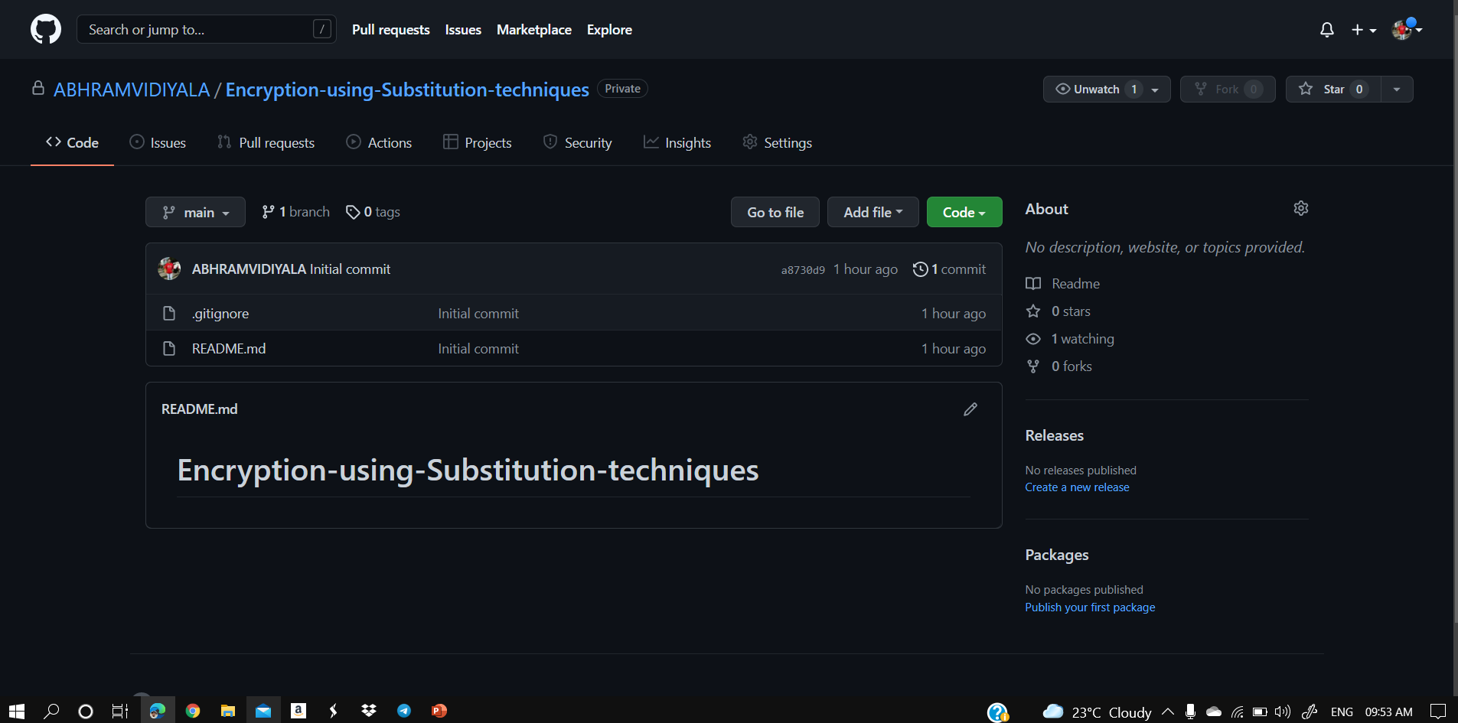
GIT HUB SET-UP

Slide 17
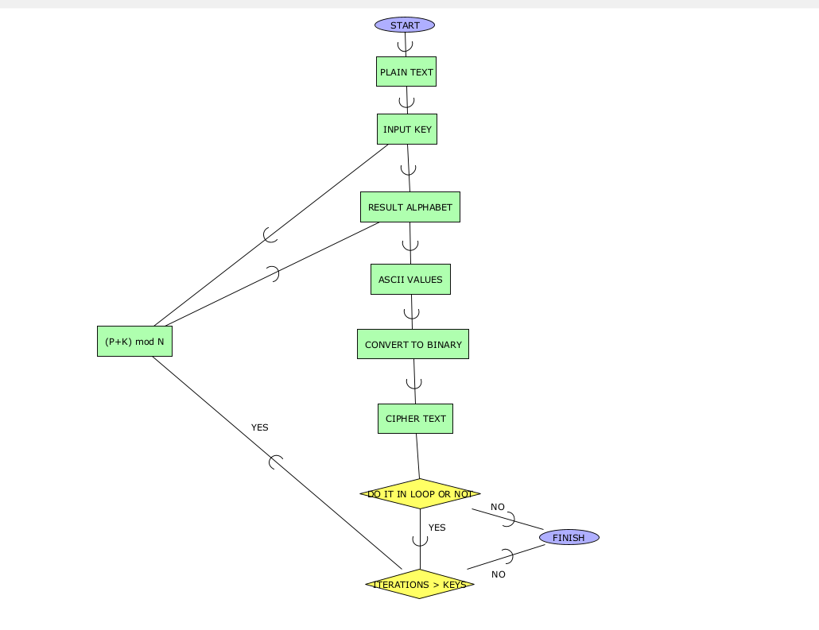
FLOW-CHART

Slide 18
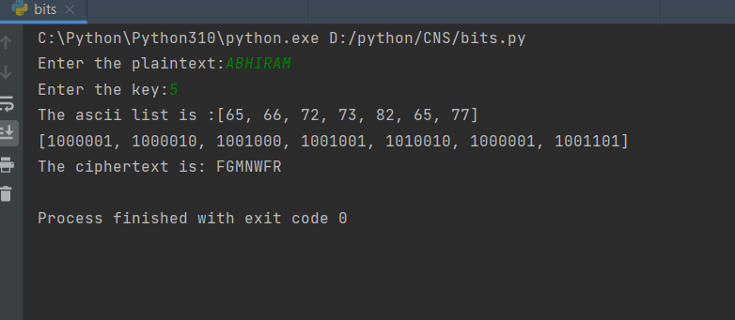
ALPHA TESTING

Slide 19
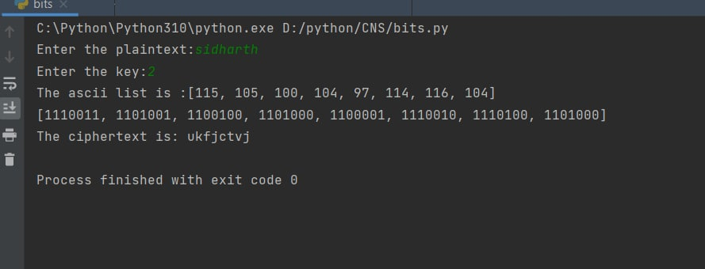

Slide 20
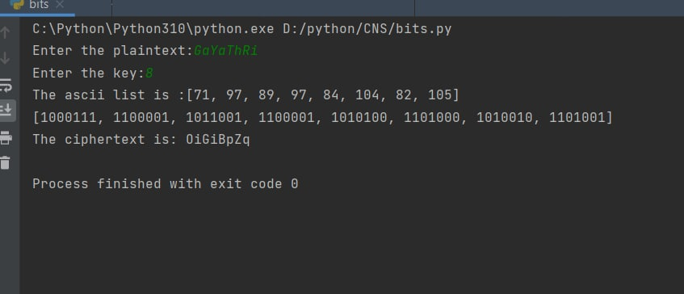

Slide 21
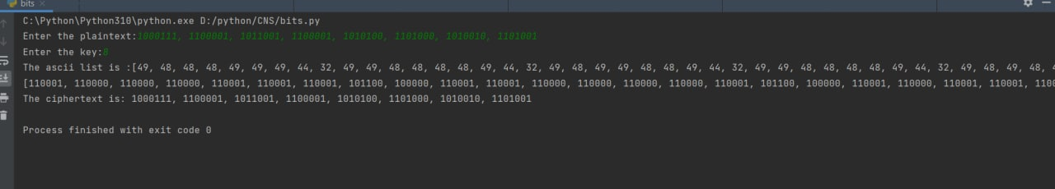

Slide 22
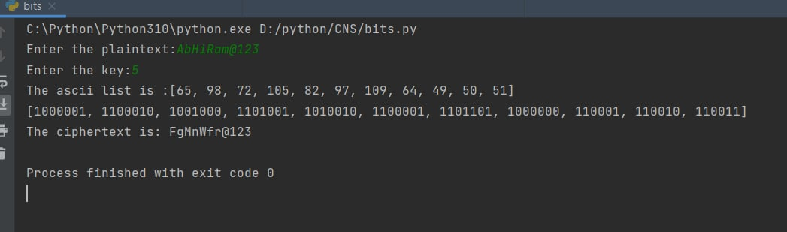

Slide 23
RESULT
With the usage of Caesar Cipher algorithm, we have seen how a plain text can be converted into Cipher text/encrypted text, which helps in ensuring data security while transferring it from one source to the other.
After the data is transferred, to read the encrypted text, we can use the decryption algorithm.
The formula of decryption is: “D_{n} (x) = (xi - n) mod 26”
We have successfully transcripted the data in to Cipher form and we have converted the given text into ASCII values.
We have obtained the binary representation of the given string.

Slide 24
CONCLUSION
In this presentation we have learned how to encrypt the data using one of the substitution techniques, which helps in ensuring the data security.
This method is useful in many ways:
It is very easy to implement.
This method is the simplest method of cryptography.
It requires only a few computing resources.
With this, we can get the ASCII values and the binary representation of the given text.

Slide 25
THANK YOU!

